Slide 1



IPRC/MET seminar, Jan 27, 2010
Improved climate simulation by MIROC5
Masahiro Watanabe
Center for Climate System Research (CCSR)
University of Tokyo
hiro@ccsr.u-tokyo.ac.jp
Primary contributors:
M Watanabe, T Suzuki, R O’ishi, Y Komuro, S Watanabe, S Emori,
T Takemura, M Chikira, T Ogura, M Sekiguchi, K Takata, D Yamazaki,
T Yokohata, T Nozawa, H Hasumi, H Tatebe, and M Kimoto

Slide 2
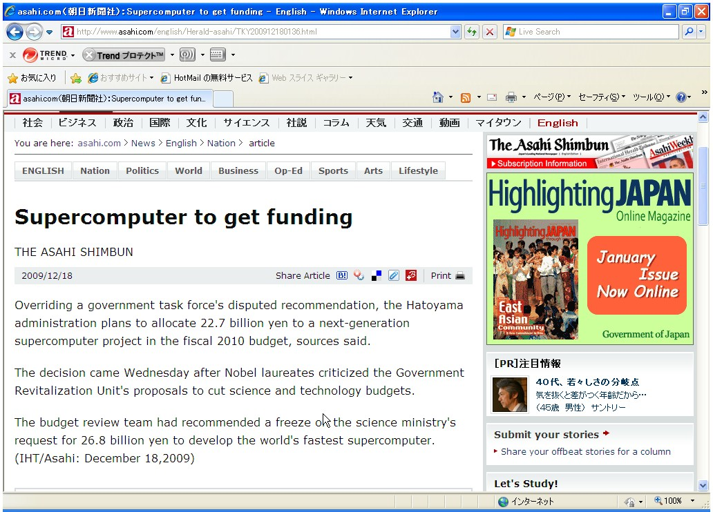
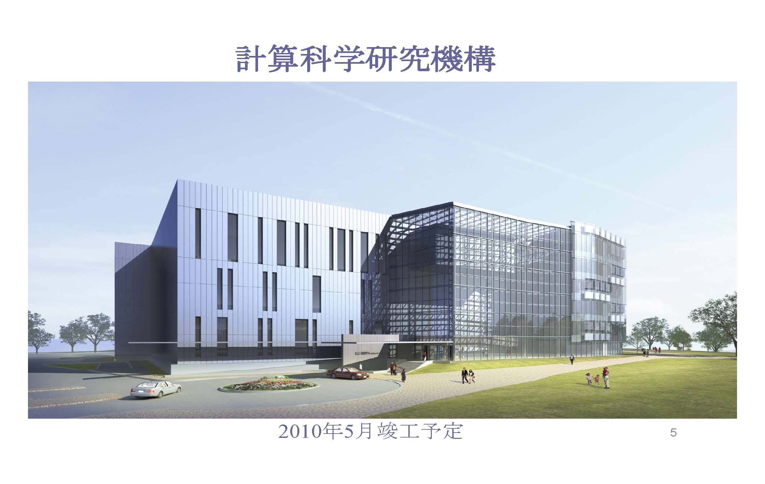
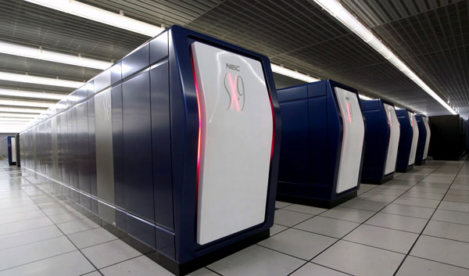
Not quite encouraging …..
Peta-flops supercomputer in Kobe
2011-
2011-
2013-??
ES2
2013??

Slide 3
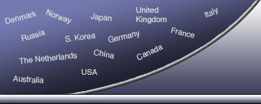
Two tasks of CMIP5
CMIP5 Coupled Model Intercomparison Project
WCRP World Climate Research Programme
I. "near-term" (decadal) hindcast/prediction simulations
II. "long-term" simulations
MIROC line ups for CMIP5
Model | Resolution | Physics pkg/ Schemes | Carbon/ Chemistry | Purpose
MIROC4 | Low/High | Old | OFF | Near-term
MIROC4-ESM | Low | Old | ON | Long-term
MIROC5 | Medium | New | OFF | Near-term
CTL run of MIROC5 is finished for 300y (will be continued till 500-1000y)

Slide 4
Improvements in MIROC5
MIROC3
MIROC5
Atmos. | Dynamical core | Spectral+semi-Lagrangian (Lin & Rood 1996) | Spectral+semi-Lagrangian (Lin & Rood 1996)
 | V. Coordinate | Sigma | Eta (hybrid sigma-p)
 | Radiation | 2-stream DOM 37ch (Nakajima et al. 1986) | 2-stream DOM 111ch (Sekiguchi et al. 2008)
 | Cloud | Diagnostic (LeTreut & Li 1991) + Simple water/ice partition | Prognostic PDF (Watanabe et al. 2009) + Ice microphysics (Wilson & Ballard 1999)
 | Turbulence | M-Y Level 2.0 (Mellor & Yamada 1982) | MYNN Level 2.5 (Nakanishi & Niino 2004)
 | Convection | Prognostic A-S + critical RH (Pan & Randall 1998, Emori et al. 2001) | Prognostic AS-type, but original scheme (Chikira & Sugiyama 2010)
 | Aerosols | simplified SPRINTARS (Takemura et al. 2002) | Full SPRINTARS + prognostic CCN (Takemura et al. 2005, 2009)
Land/ River |  | MATSIRO+fixed riv flow | new MATSIRO+variable riv flow
Ocean |  | COCO3.4 | COCO5
Sea-ice |  | Single-category EVP | Multi-category EVP
Mean climatology
zonal mean atmosphere
sea-ice
equatorial waves (incl. MJO)
  SST & precipitation
⇒ ENSO simulation
    Cloud physical properties
⇒ climate sensitivity
…..

Slide 5
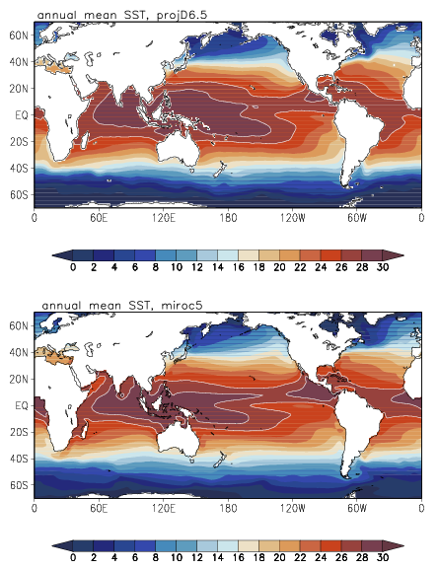
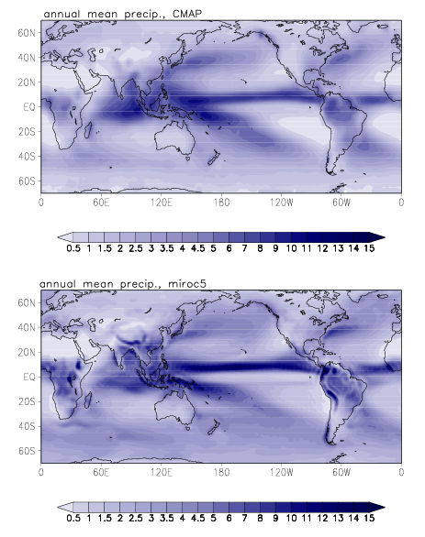
CTL climatology
SST
Precipitation
OBS
MIROC5
Notes:
5

Slide 6


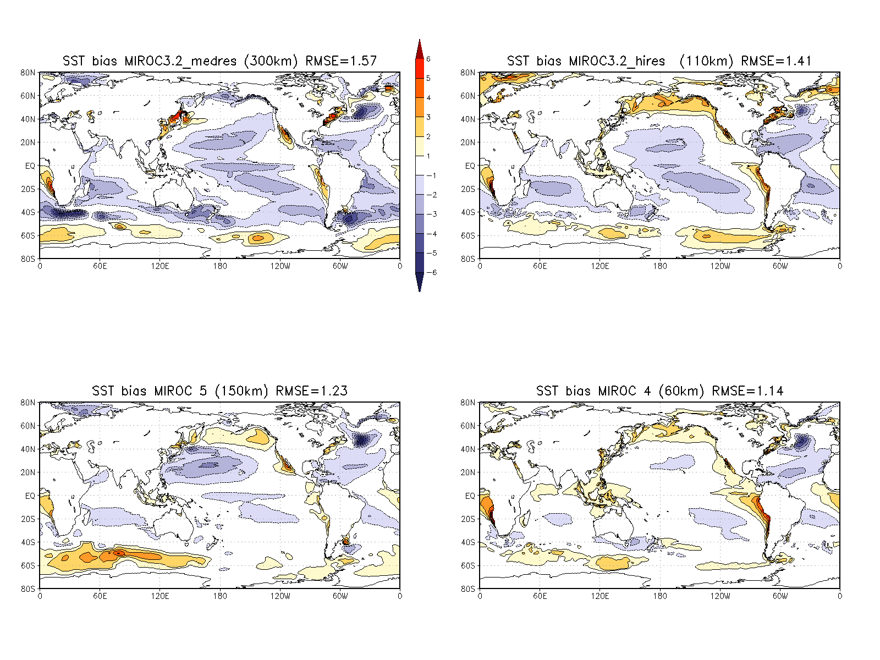
SST bias
MIROC 3.2 (300km) rmse=1.6
MIROC 3.2 (110km) rmse=1.4
for AR4
MIROC 5 (150km) rmse=1.2
MIROC 4 (60km) rmse=1.1
for AR5
100km Ocean
20km Ocean

Slide 7
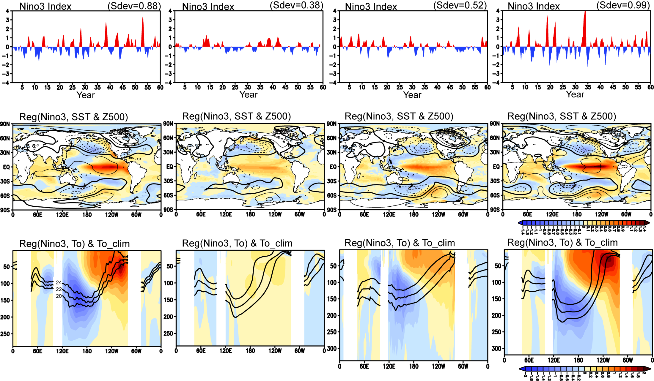
ENSO in obs and MIROC family
Obs.
(ProjD_v6.7 &ERA40)
MIROC3. T42
MIROC4. T213
MIROC5. T85
Courtesy of M Mori

Slide 8
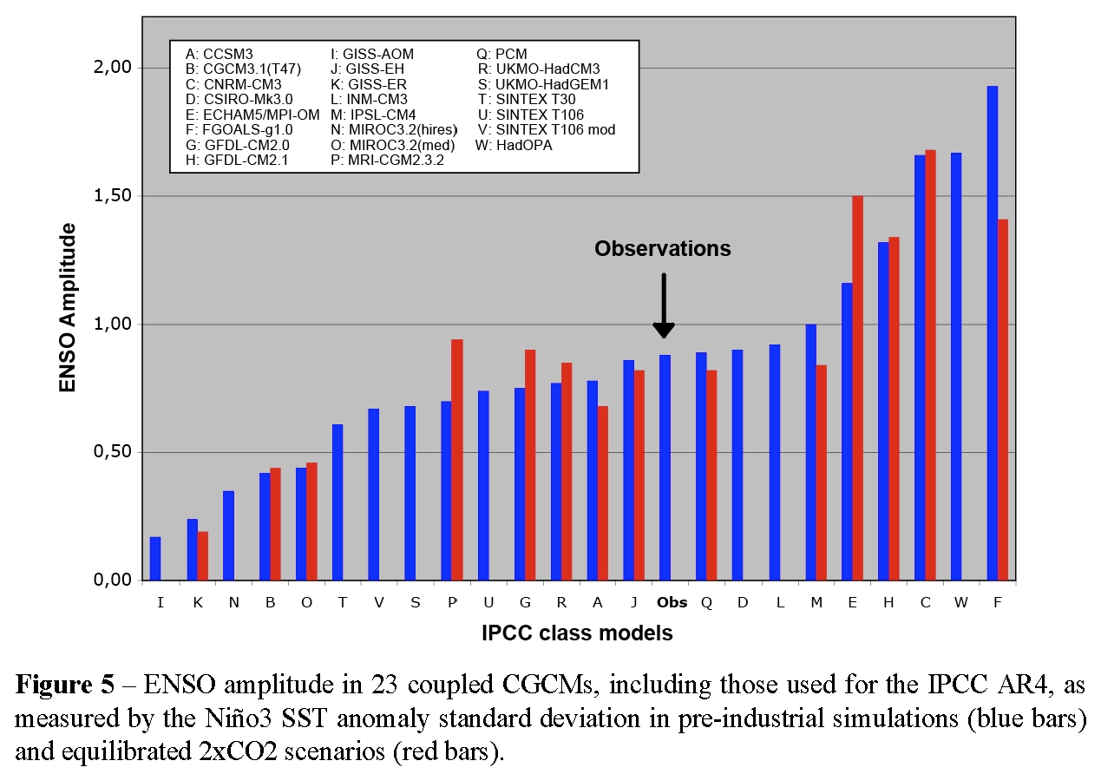
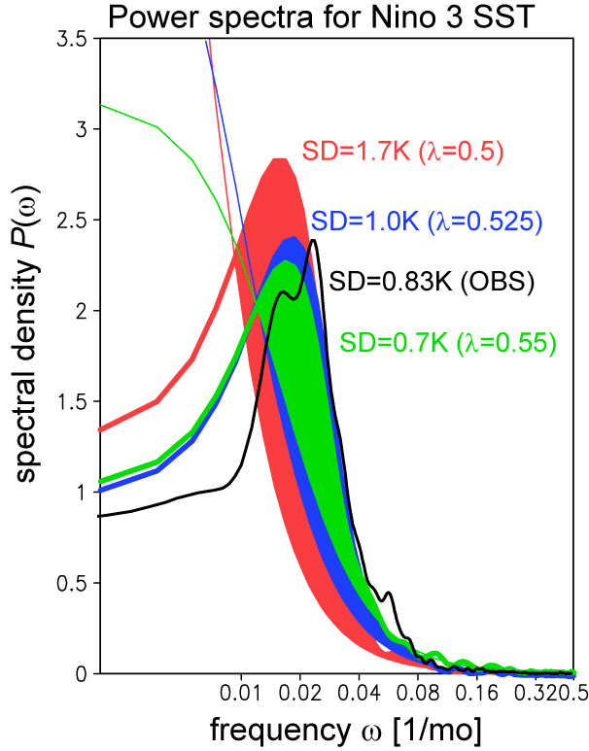
ENSO in MIROC5
Parameter affecting the efficiency of the entrainment, λ,
λ=0.5
λ=0.525
λ=0.55
MIROC3.2
Guilyardi et al. (2009)
What is likely to happen:
Large λ → deep cumulus suppressed → strong moisture contrast → drying cold tongue
→ precip. response to El Nino confined to the central Pacific → weaker Bjerknes feedback

Slide 9
Convective control of ENSO?
Most of the recent studies point out the role of cumulus parameterization in ENSO simulations
CCSM3 : Cumulus convection (Neale et al. 2008)
GFDL CM2: Cumulus convection (Wittenberg et al. 2006)
IPSL: Cumulus convection (Guilyardi et al. 2009)
SNU: Cumulus convection (Kim et al. 2008)
HadCM3: Low cloud (Toniazzo et al. 2008)
What is meaningful with MIROC5?
ー ENSO controlled by a single parameter (1D phase space)
ー mean state changes little
Generality ?
ー diff model has diff bias, so the mechanisms will depend on model

Slide 10
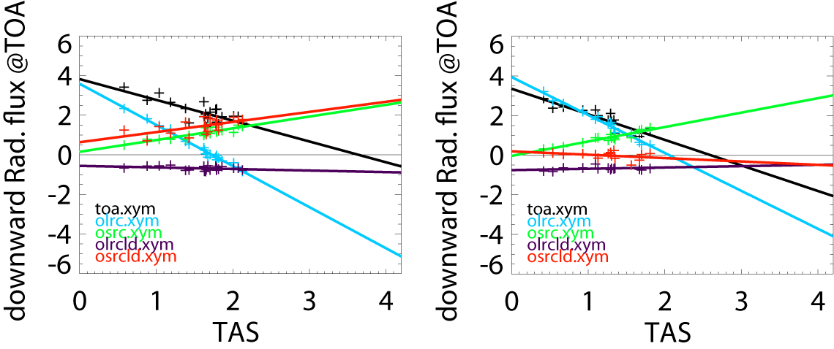
Equilibrium climate sensitivity
Gregory plots for 2xCO2
Old MIROC
New MIROC
N = F − α ∆T
SWcloud > 0
SWcloud < 0
α=3.6K
α=2.6K
LW+SW
LWclr
SWclr
LWcloud
SWcloud
ΔT
ΔT
Courtesy of H Shiogama
Low-cloud increase ⇒ negative feedback
GFDL
Old
New
NCAR

Slide 11
IPRC/MET seminar, Jan 27, 2010
Summary
New version of MIROC (MIROC5) developed
Several aspects of climate mean and variability
significantly improved
Will be used in the next stage for:
  decadal prediction
  mechanism studies

Slide 12
backup

Slide 13
、というわけで
MIROC5開発中（というかほぼ終わった）
IPCC AR5本番実験
派生研究ネタ
  Team ENSO
  Team 気候感度
  Team 古気候
  Team モンスーン
  Team Decadal (SPAM)
  Team 季節予報
  (SPAM seasons)
メンバー募集中
メンバー募集中
メンバー募集終了
SPAM:
System for
Prediction and Assimilation by
MIROC
メンバー募集中

Slide 14
New version of MIROC
MIROC3
MIROC5
Atmos. | Dynamical core | Spectral+semi-Lagrangian (Lin & Rood 1996) | Spectral+semi-Lagrangian (Lin & Rood 1996)
 | V. Coordinate | Sigma | Eta (hybrid sigma-p)
 | Radiation | 2-stream DOM 37ch (Nakajima et al. 1986) | 2-stream DOM 111ch (Sekiguchi et al. 2008)
 | Cloud | Diagnostic (LeTreut & Li 1991) + Simple water/ice partition | Prognostic PDF (Watanabe et al. 2009) + Ice microphysics (Wilson & Ballard 1999)
 | Turbulence | M-Y Level 2.0 (Mellor & Yamada 1982) | MYNN Level 2.5 (Nakanishi & Niino 2004)
 | Convection | Prognostic A-S + critical RH (Pan & Randall 1998, Emori et al. 2001) | Prognostic AS-type, but original scheme (Chikira & Sugiyama 2010)
 | Aerosols | simplified SPRINTARS (Takemura et al. 2002) | Full SPRINTARS + prognostic CCN (Takemura et al. 2005)
Land/ River |  | MATSIRO+fixed riv flow | new MATSIRO+variable riv flow
Ocean |  | COCO3.4 | COCO5
Sea-ice |  | Single-category EVP | Multi-category EVP

Slide 15
温暖化予測の不確定性
予測期間に対する不確定性要因の比率
近い将来の予測には
モデル自身の不確定性
(誤差) が大きく影響する
シナリオ
モデル
2000 2020 2040 2060 2080 2100
年
Hawkins and Sutton (2008)

Slide 16
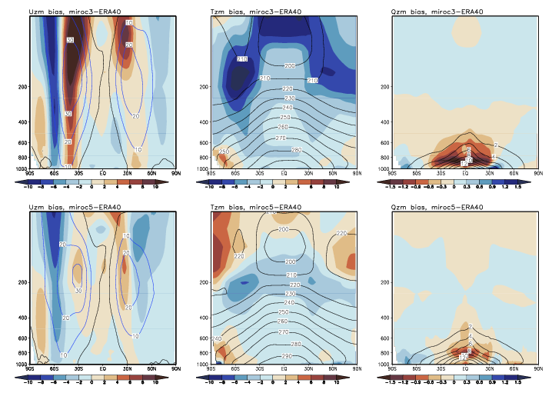
CTL climatology (zonal mean bias)
U
T
q
MIROC3
MIROC5
Notes:
16

Slide 17
ENSO in MIROC5
State-dependent entrainment rate is introduced in the new cumulus scheme
Assumption between the entrainment rate ε and updraft velocity w (Gregory 2001)
The parameter λ is found to control the frequency of
deep cumulus clouds (λ->large, suppress deep clouds)
hence affect ENSO amplitude
λ=0.5
λ=0.55
λ=0.525
MIROC3.2
Guilyardi et al. (2009)

Slide 18
PDO
7yr low-pass SST anomalyの分散
OBS
MIROC5
MIROC3.2med

Slide 19
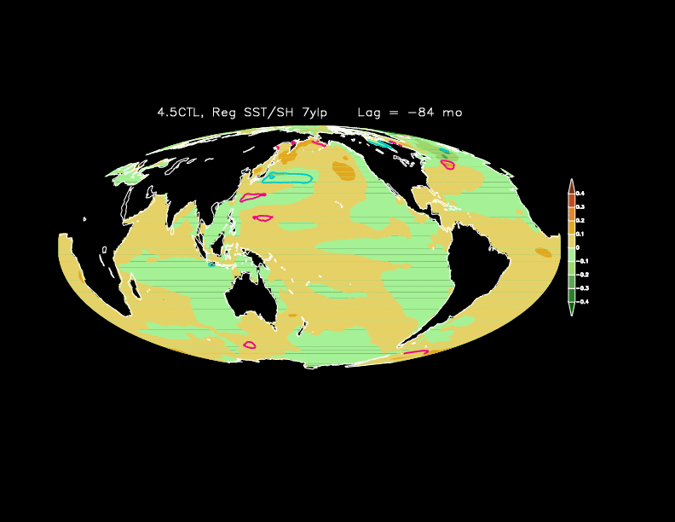
PDO
7yr low-pass SST anomalyのEOF1
OBS
MIROC5
Courtesy of M Mori

Slide 20
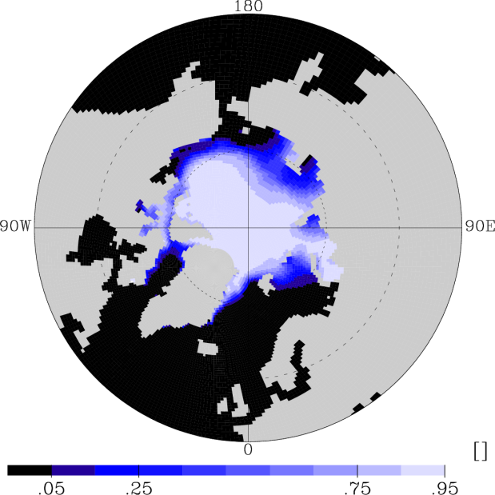
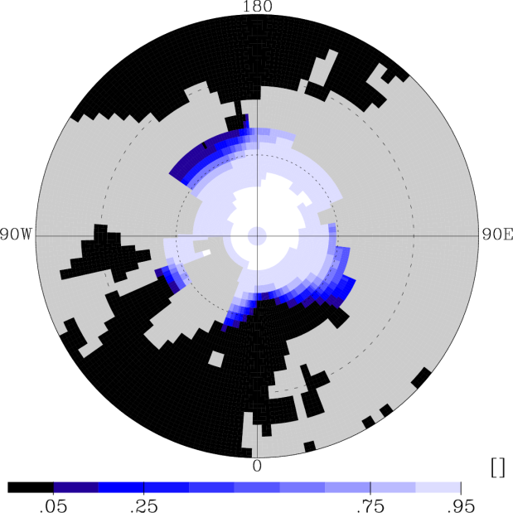
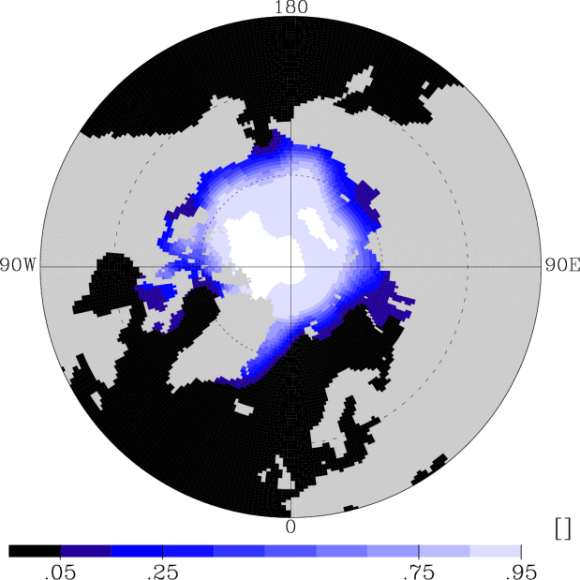
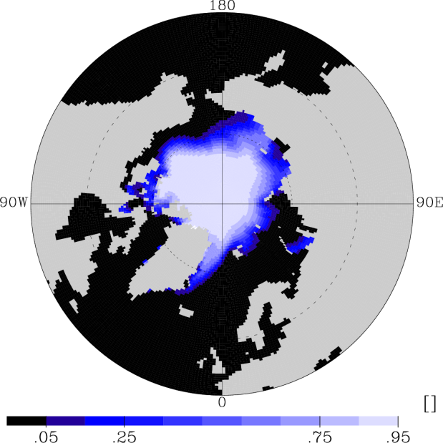
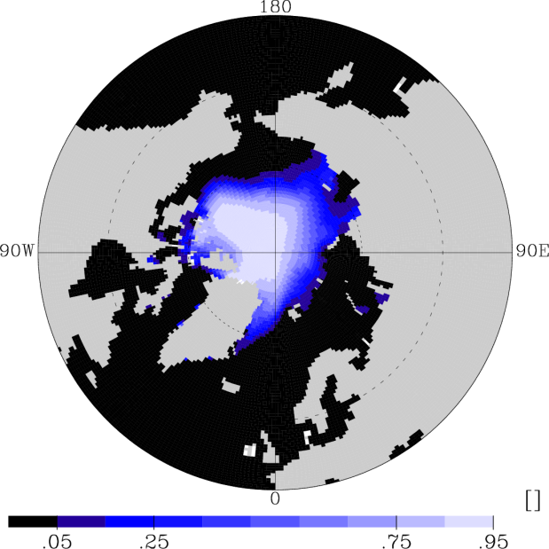
北半球海氷（密接度 A_{I} Sep.）
MIROC5-T85
MIROC3.2-T42
obs.（HadISST）
MIROC4-T213
MIROC3.2-T106
Notes:
20

Slide 21
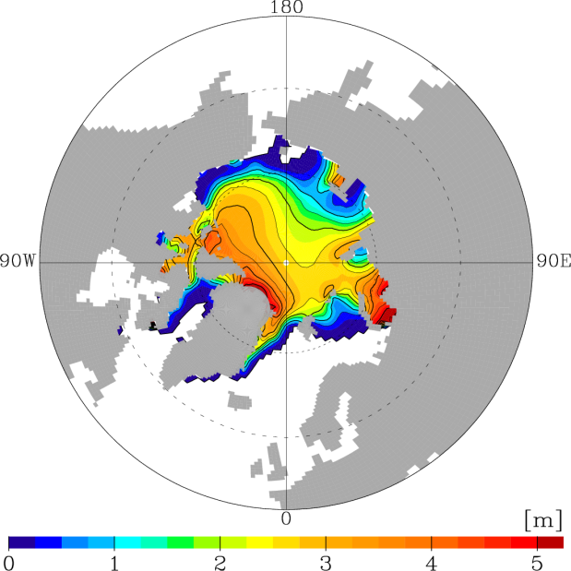
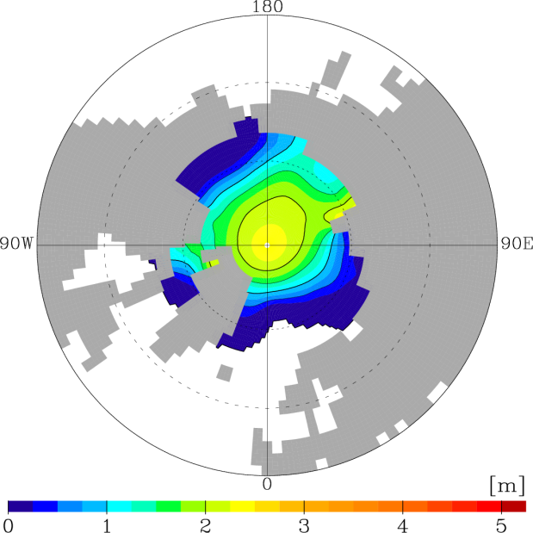
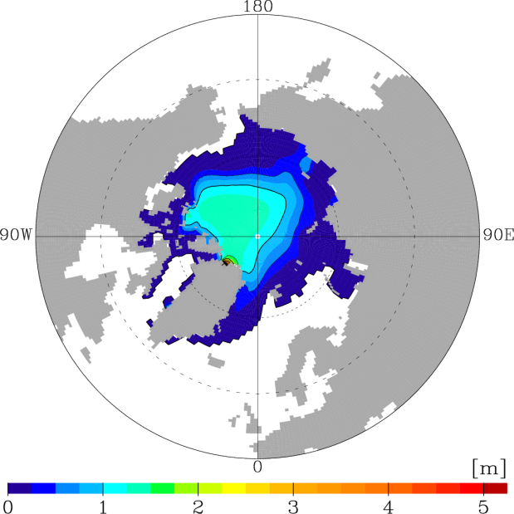
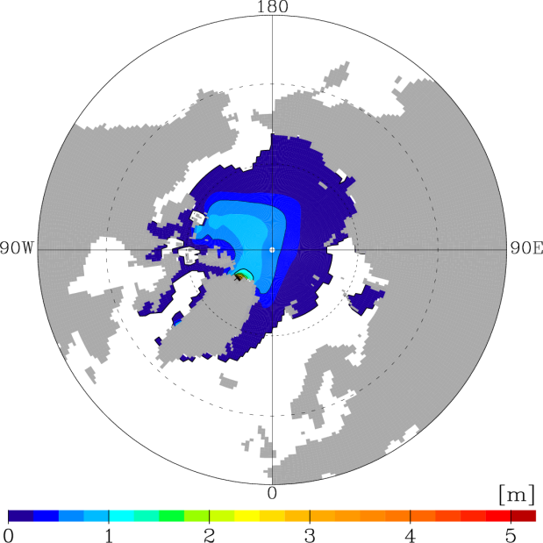
北半球海氷（厚さ A_{I}×H_{I} Sep.）
MIROC5-T85
MIROC3.2-T42
obs.
2.2-2.5 m
（夏季潜水艦観測
/北極海海盆内平均）
(Yu et al., 2004)
MIROC4.5-T85
→ 2.57 m
（AJO平均
/北極海海盆内平均）
MIROC4-T213
MIROC3.2-T106
Notes:
21

Slide 22
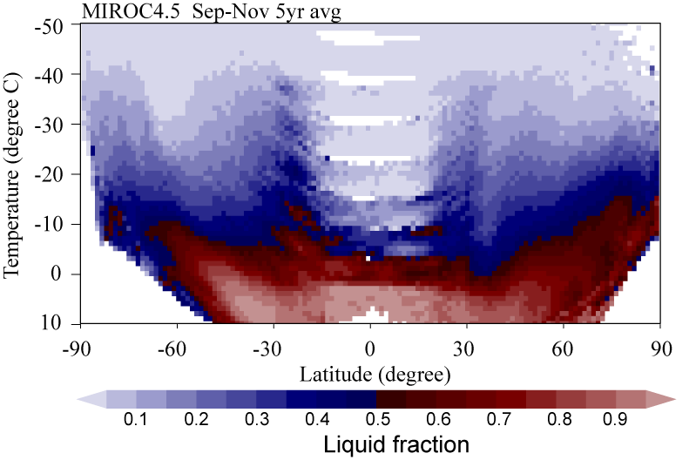
Property of MIROC5
CloudSAT and CALIPSO
* launched in April, 2006
* 3D cloud property w/ rader/
lidar measurements
prognostic PDF cloud scheme
prognostic ice microphysics
⇒ better representation of cloud and
cloud-radiative feedback
⇒ how to validate?
Latitude - temperature cross section of the ratio of cloud particle type
Sep-Nov 2006, CloudSAT/CALIPSO
Sep-Nov climatology, MIROC4.5
Courtesy of H Okamoto

Slide 23
Property of MIROC5
215 hPa cloud ice
Waliser et al. (2009)

Slide 24
Climate sensitivity
Gregory plots for 2xCO2
N = F − α ∆T
Due to different α (feedback)
N
(MIROC3->MIROC5)
0
Due to different
F (forcing)
ΔT
(Gregory & Webb 2008)

Slide 25

水惑星
http://www-pcmdi.llnl.gov/projects/amip/ape/
Control run における全球平均降水量・蒸発量
P
E
P_{cum}
P_{lsc}
E-P
Control run における
経度平均降水量・蒸発量
P
E

Slide 26
Aquaplanet exp.
SST+2/control diff
Relative humidity diff.
“climate sensitivity”
GFDL
(high sensitivity)
MIROC5
(-0.248,0.373)
★
K-1 Japan
(0.197,0.625)
★
NCAR
(low sensitivity)
Medeiros et al. (2008)

Slide 27
Aquaplanet exp.
SST+2/control diff
Cloud fraction diff.
“climate sensitivity”
GFDL
(high sensitivity)
NICAM
(-0.293,0.334)
MIROC5
(-0.248,0.373)
oldcld
(-0.04,0.530)
★
★
K-1 Japan
(0.197,0.625)
★
★
★
★
NCAR
(low sensitivity)
oldcum
(-0.154,0.393)
oldvdf
(-0.237,0.373)
Medeiros et al. (2008)

Slide 28
、というわけで
MIROC5開発中（というかほぼ終わった）
IPCC AR5本番実験
派生研究ネタ
  Team ENSO
  Team 気候感度
  Team 古気候
  Team モンスーン
  Team Decadal (SPAM)
  Team 季節予報
  (SPAM seasons)
メンバー募集中
メンバー募集中
メンバー募集終了
SPAM:
System for
Prediction and Assimilation by
MIROC
メンバー募集中

Slide 29
ENSO changes
ENSO changes
Ratio of SD of the SLP EOF1 in SRES A2 runs (2051-2100)
Mean state changes
IPCC( 2007)
R( linear trend in 1% CO2 increase run, EOF1 in CTL, 10S-10N, 120E-80W)
El Nino-like mean state in the warmed climate may be robust,
but …..
large uncertainty in the change in ENSO amplitude

Slide 30
Modeling issue
Increasing resolution vs Improving model

