Slide 1
An introduction to climate modeling and climate change simulation
ICISTS-KAIST 2009, 20-21 Aug 2009, Daejeon, Korea
Masahiro Watanabe
Center for Climate System Research
The University of Tokyo
hiro@ccsr.u-tokyo.ac.jp

Slide 2
Outline:
Climate system - what is the essence?
Climate model - what is it?
Climate change simulation
Weather forecast and climate prediction
Uncertainty
From AR4 to AR5

Slide 3
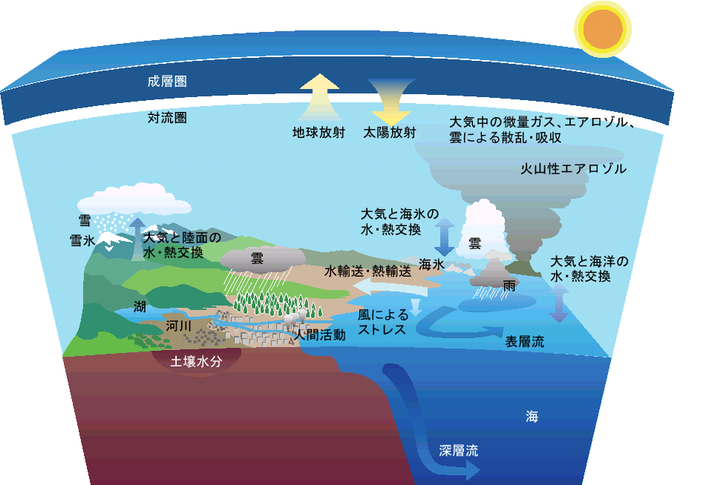
Climate system
Open dissipative system
Solar insolation is a unique energy input = approx 240 W/m²
Climate System
stratosphere
troposphere
absorption due to
cloud, aerosol, and other species
Earth radiation
solar
insolation
volcanic aerosols
snow
ice
atmosphere-ice
heat/water exchange
atmosphere-land
heat/water exchange
cloud
cloud
heat/water trans.
sea-ice
atmosphere-ocean
heat/water exchange
lake
rainfall
river
wind
stress
human activity
sfc currents
soil wetness
ocean
deep currents

Slide 4
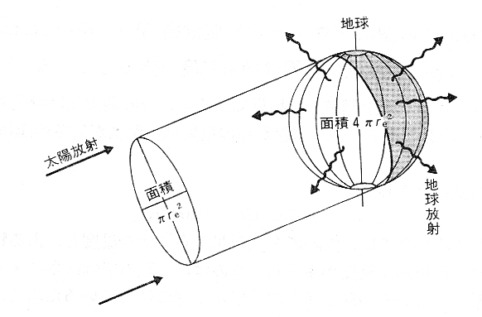
Climate system
Open dissipative system
Solar insolation is a unique energy input = approx 240 W/m²
Earth
Radiative equilibrium
area=4πr²
Solar radiation S
area
=πr²
Terrestrial
radiation R

Slide 5
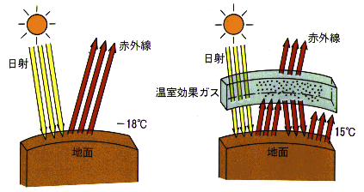
Climate system
Open dissipative system
Solar insolation is a unique energy input = approx 240 W/m²
Greenhouse effect
w/o atmosphere
w/ atmosphere
Terrestrial
radiation
Solar
radiation
Greenhouse
gases
Greenhouse effect is a crucial process
that maintains present climate

Slide 6
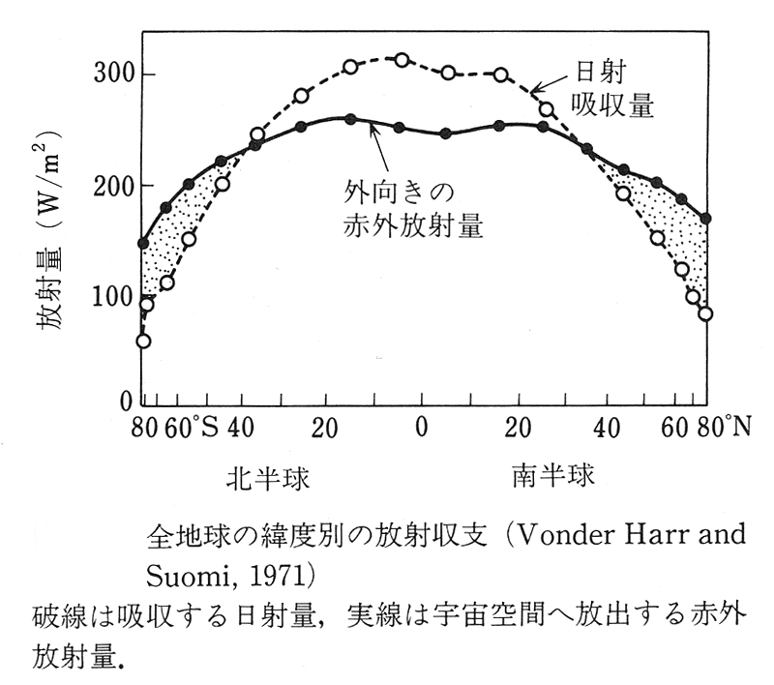
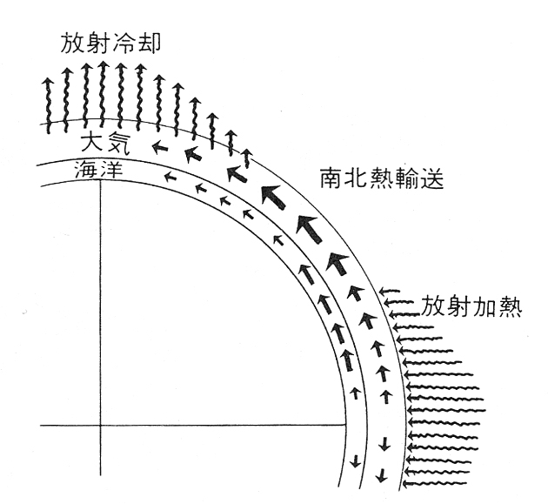
Climate system
Open dissipative system
Solar insolation is a unique energy input = approx 240 W/m²
Role of the general circulation
Incoming
Shortwave
Radiation
Net radiative
cooling
Poleward
heat transport
Outgoing
Longwave
Radiation
Radiative flux [W/m²]
Net radiative
heating
Local radiative imbalance
Meridional energy transport by atmosphere & ocean

Slide 7

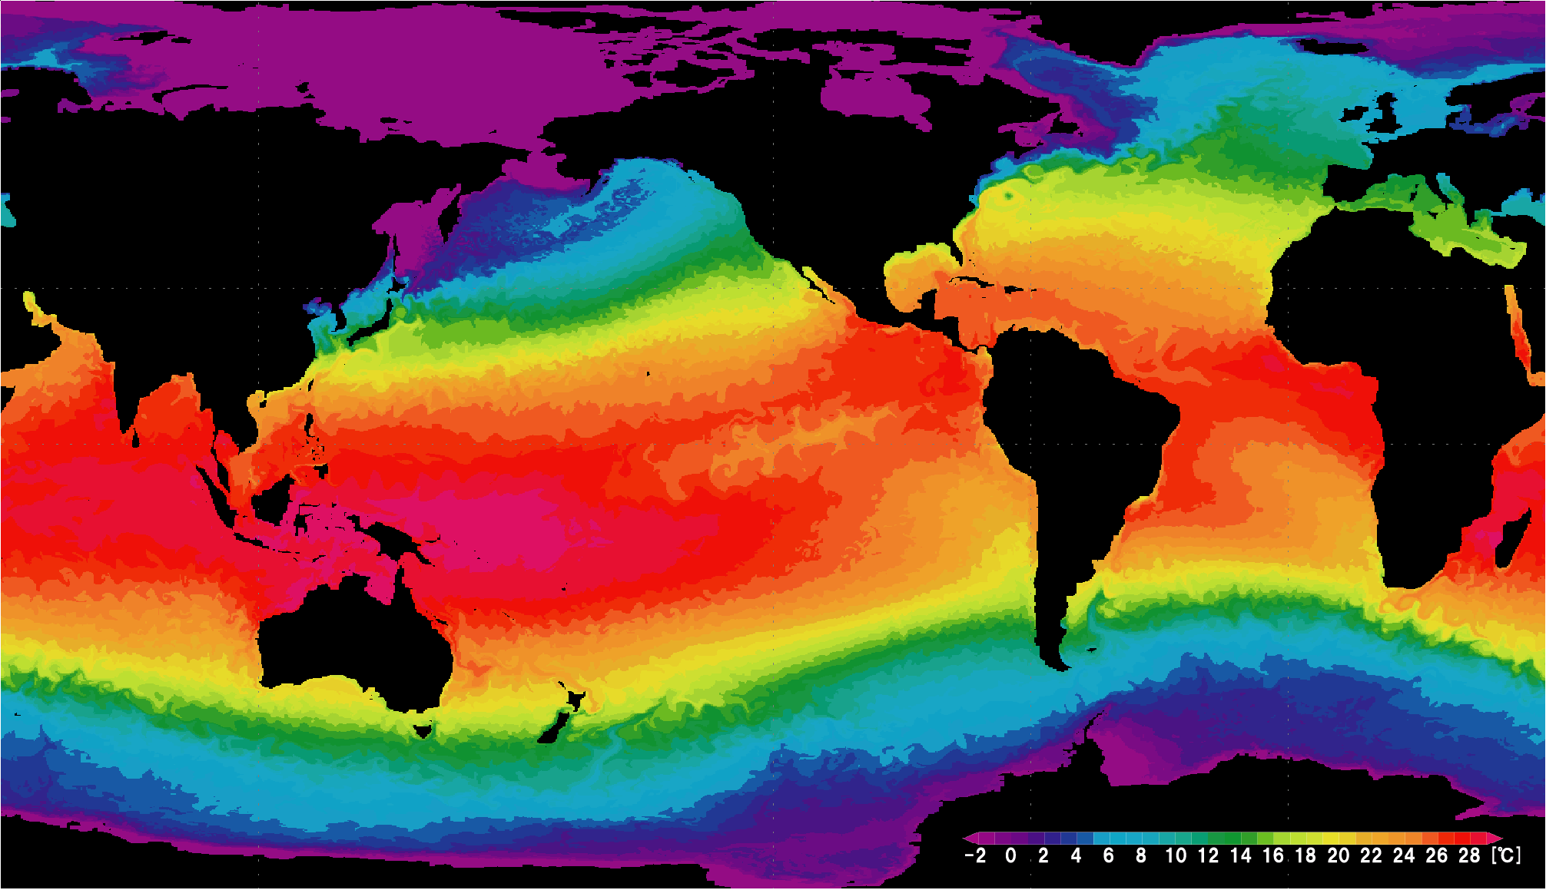
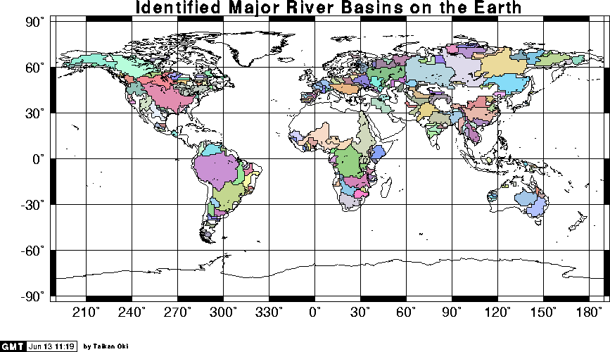
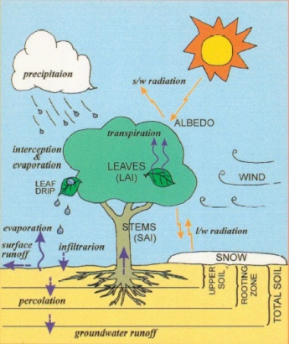
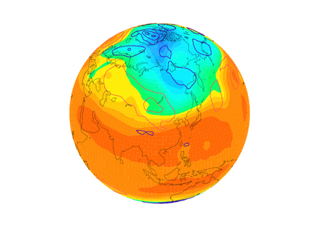
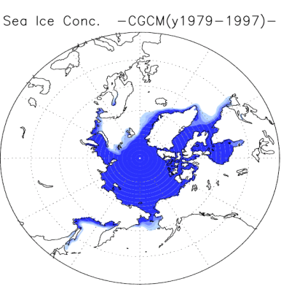
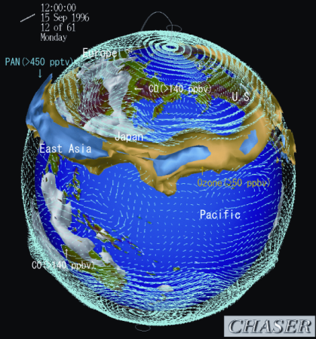

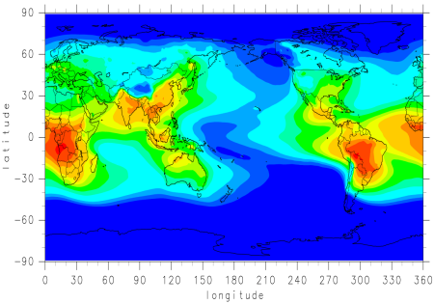
Climate model (CGCM)
Ocean sub-model (OGCM)
(heat, salt & momentum)
Land sub-model
（incl. river, lake & vegetation）
fresh water
Atmosphere sub-model
(AGCM)
Sea-ice sub-model
(dynamic & thermodynamic)
Chemistry module
Aerosol module
heat/water/momentum
exchange
interaction thru radiation
・ model’s substance = a huge group of program codes
・ basic governing equations are known (but…)
・ does not include ecosystem and human activity at present

Slide 8
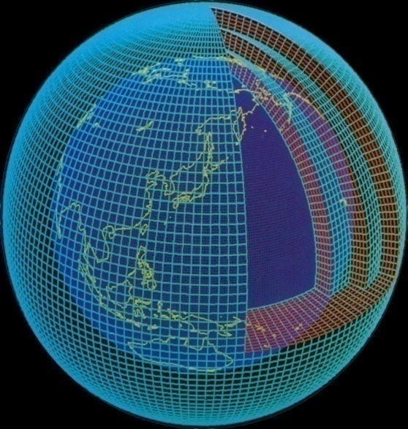
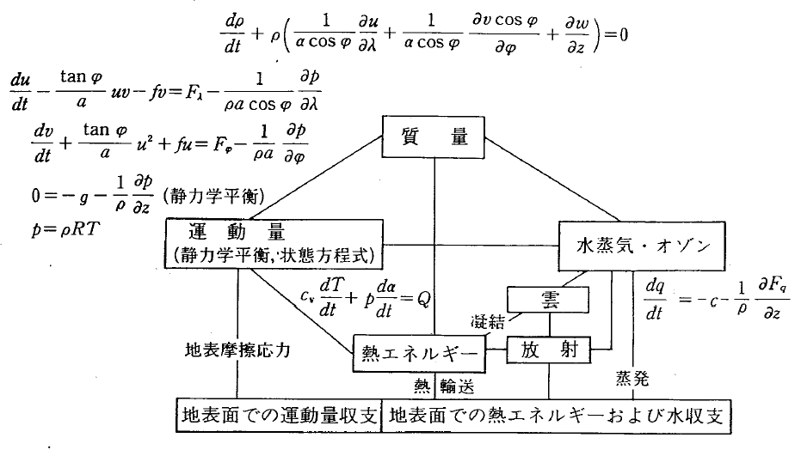
An example: Atmospheric component model
Governing equations for the AGCM
mass
ⓒJMA
momentum
(hydrostatic eq&eq of state)
water vapor
cloud
condensation
surface stress
enthalpy
radiation
evaporation
heat transport
sfc momentum exc
sfc heat & moisture exchange

Slide 9
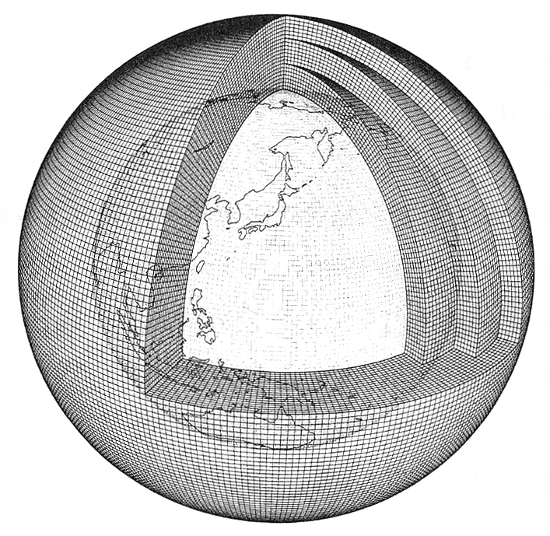
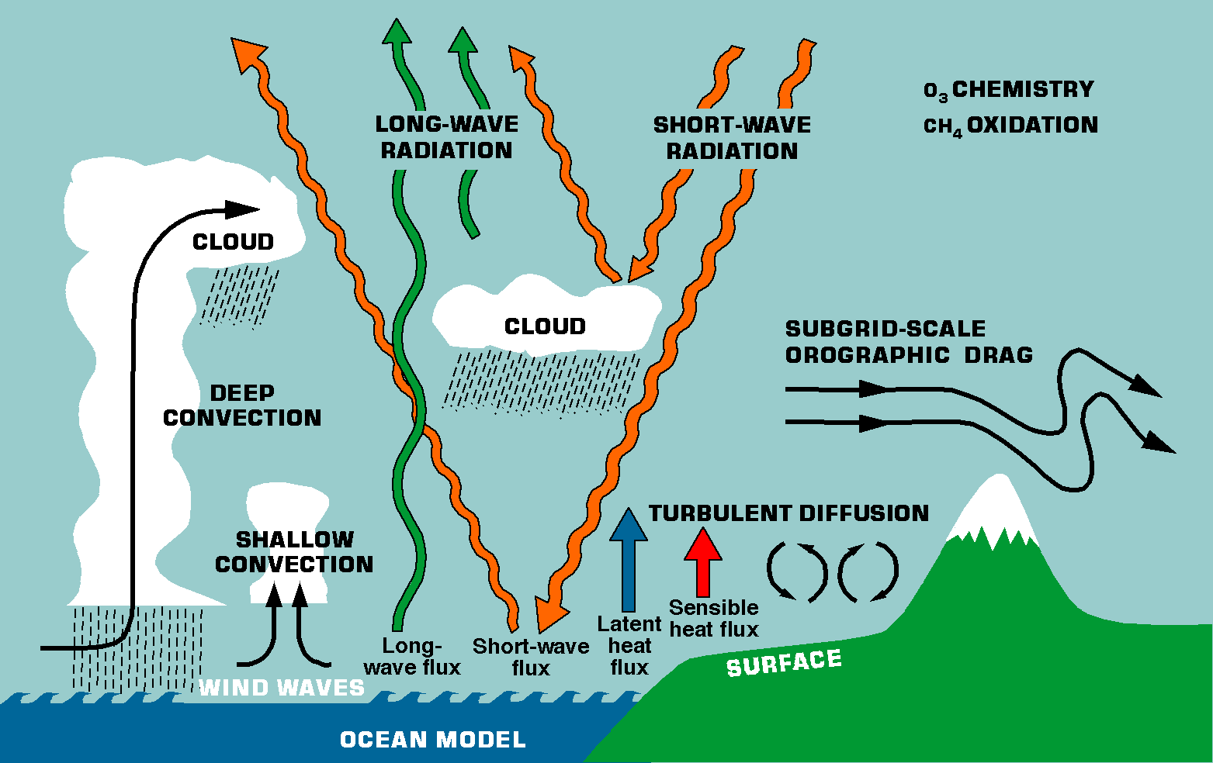
Parameterization problem
Fluid phenomena have continuous scales (from mm to 10⁴ km);
resolving all the scales is NOT possible even in a far future
We have to parameterize small-scale (unresolved) effects by using large-scale (resolved) variable
Global atmosphere model
No. grid>8million
Beljaars (2004)

Slide 10
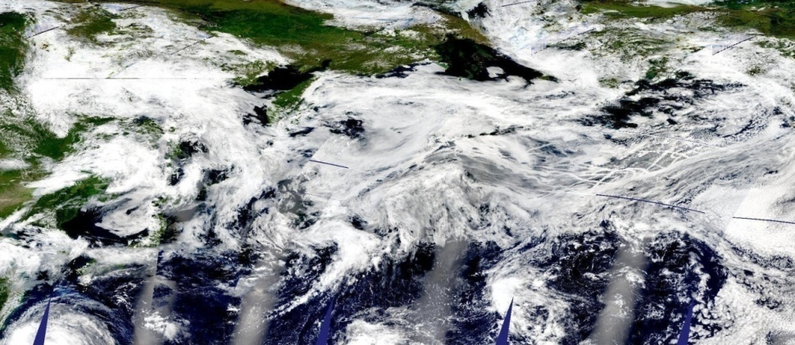
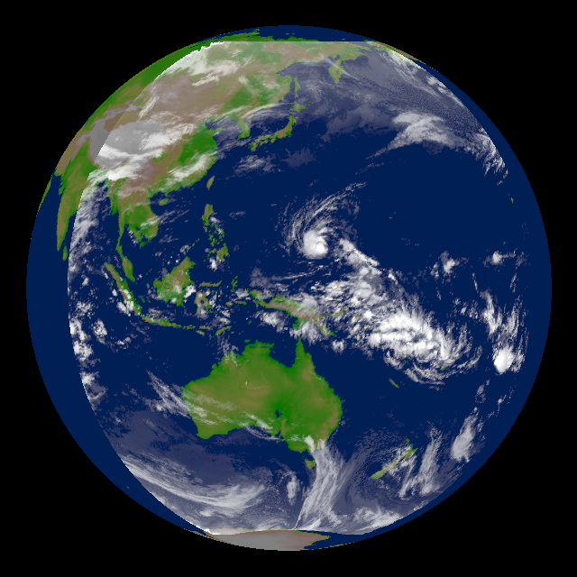
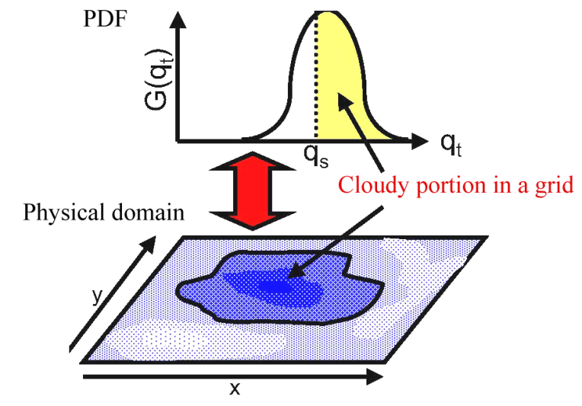
Example of parameterization: clouds
Clouds are important elements of climate, but highly inhomogeneous…
Observation: TBB from GOES-9
“All or nothing” cloud is too crude for GCM !!
-> We assume a probability distribution of
the sub-grid scale moist fields to represent
partial clouds
Parameterization ≠ empirical rule,
based on small-scale physics; but
needs assumptions, leading to a variety of the scheme.

Slide 11
Climate system and climate model: summary
Climate system
Climate is a complex system involving various
interactions among sub-systems
Yet, essence is the energy balance and general
circulation constrained by the dynamical and
thermodynamic principles
Climate model
Climate model is based on physical rules
(external conditions are just a few)
Climate model is only the way to represent the complex
climate system as a whole
(model spontaneously produces natural variability)
Climate model is not perfect, but includes
parameterization for unresolved processes

Slide 12
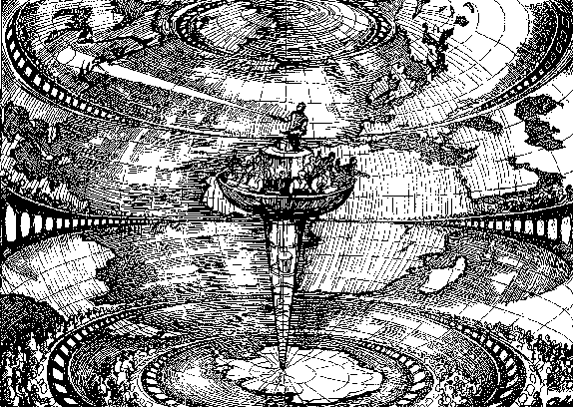
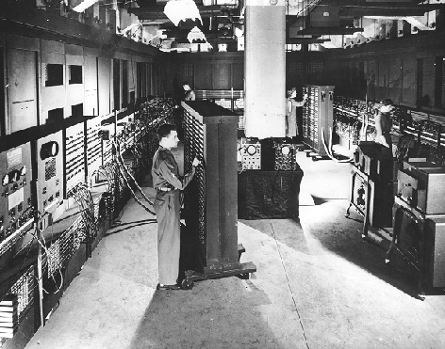

Model and computer resources
First trial of NWP(1922)
History of climate modeling
originates in the weather forecast
“Richardson’s dream”
First success of NWP (1950)
ENIAC
Atmospheric GCM (1970s)
Coupled Atmosphere-Ocean
GCM (1980s)
IPCC Climate change
simulation (1990s)
Earth Simulator
1st high-resolution climate
change simulation (2002)
Climate modeling crucially depends on the computer power; increasing model resolution is still hard (2⁴=16 times faster machine for doubling resolution)

Slide 13

Climate “Centers of Excellence”
Major climate modeling centers in the world
INM
(Russia)
BCC
LASG
(China)
MPI
(Germany)
BCCR
(Norway)
UKMO
(UK)
CCC
(Canada)
MIROC
MRI
(Japan)
CNRM
IPSL
(France)
NCAR
GISS
GFDL
(USA)
INGV
(Italy)
ECHO
(Germany/Korea)
CSIRO
(Australia)

Slide 14
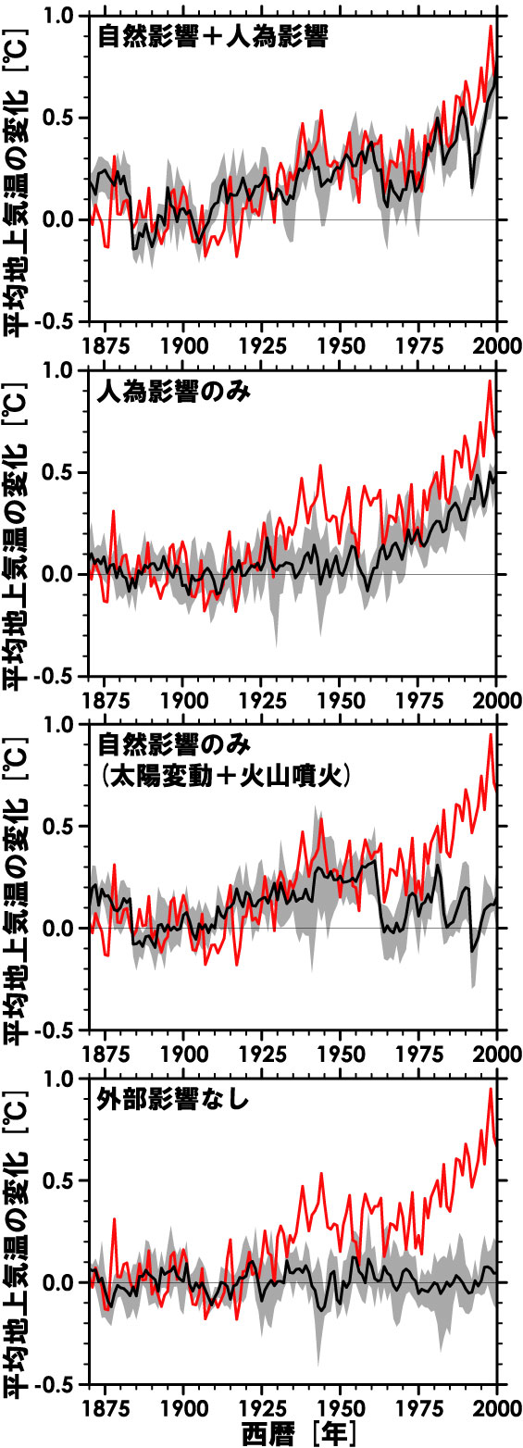
Can climate model reproduce the past?
20 century ensemble climate simulation using MIROC
Full forcing
(Natual + Anthropogenic)
Anthropogenic forcing
Only
Global mean surface air temperature anomaly (ºC)
Global mean surface air temperature anomaly (ºC)
Natural forcing Only
(Solar + Volcano)
No forcing
Year
Year
Year
Year
Nozawa et al. (2005)

Slide 15
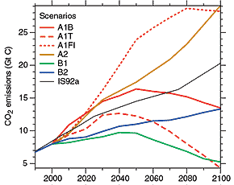
How to do the climate projection
IPCC( 2007)
Emission scenario (IS92/SRES)
Climate response
heavily dependent
on fossil fuel
well balanced
less dependent
on fossil fuel
2000 2020 2040 2060 2080 2100
Likely range: 1.1-2.9°C (B1), 2.4-6.4°C (A1FI)

Slide 16
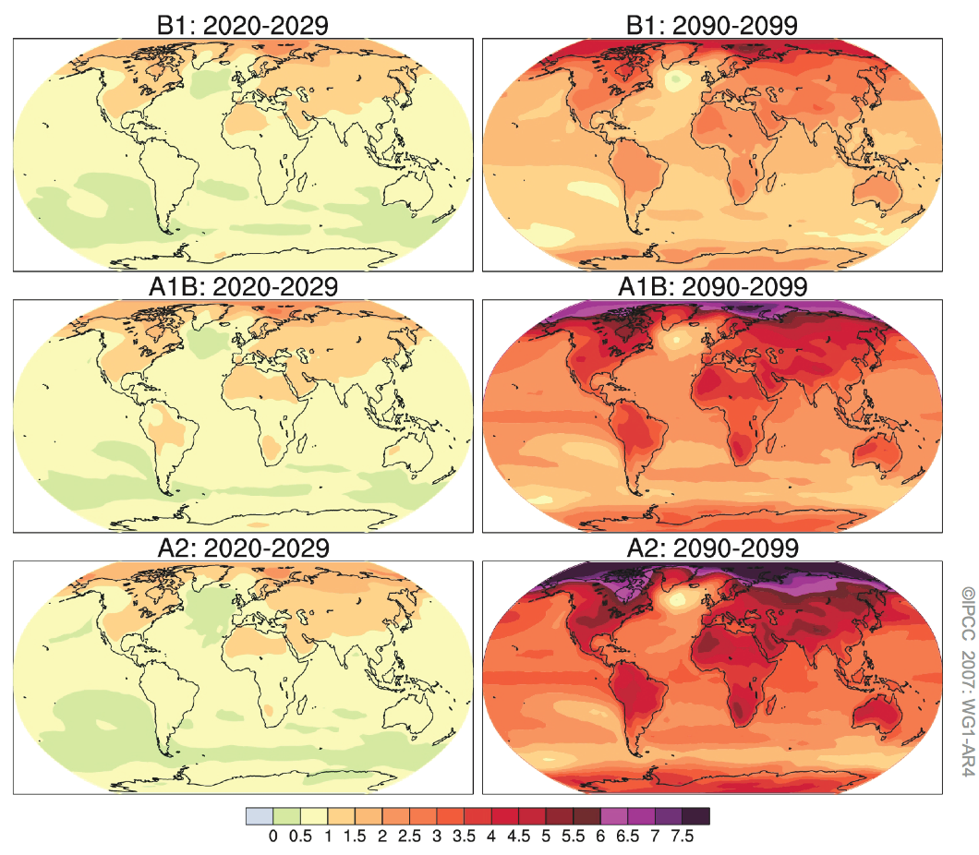
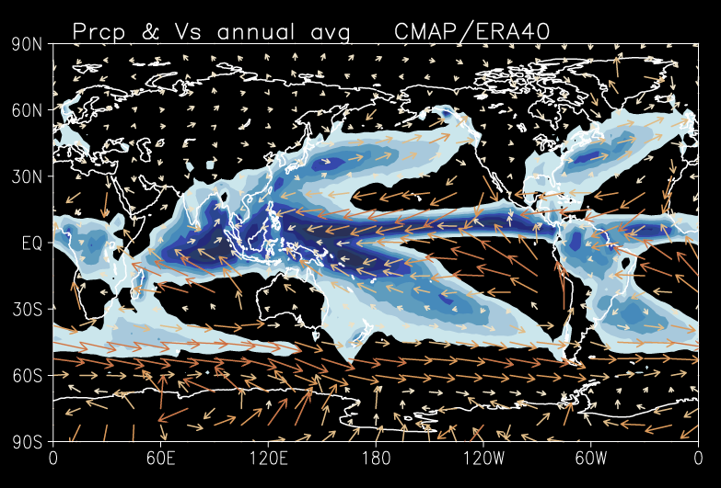
Global warming projection
Surface temperature and precipitation changes (relative to 1980-1999)
Present day precipitation
2980-2099
← 現在の降水量平年分布
IPCC (2007)

Slide 17

Weather forecast vs climate prediction
A common confusion between weather and climate
arises when scientists are asked how they can predict
climate 50 years from now when they cannot predict
the weather a few weeks from now.
IPCC (2007)
Weather --- predictability of the 1st kind
Time evolution of initial perturbations in the Lorenz model
Palmer (1993)
A point in the Lorenz system corresponds to a circulation pattern
(u,v,T,Ps) in the real atmosphere

Slide 18
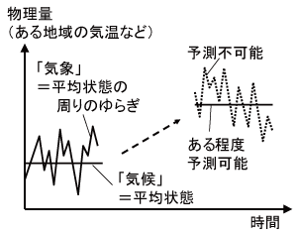
Weather forecast vs climate prediction
A common confusion between weather and climate
arises when scientists are asked how they can predict
climate 50 years from now when they cannot predict
the weather a few weeks from now.
IPCC (2007)
Climate --- predictability of the 2nd kind
Prediction
in terms of
the PDF change
Physical quantity
unpredictable
weather=perturbation
around the “mean”
may partly predictable
climate=“mean”
time

Slide 19
Weather forecast vs climate prediction
A common confusion between weather and climate
arises when scientists are asked how they can predict
climate 50 years from now when they cannot predict
the weather a few weeks from now.
IPCC (2007)
Climate --- predictability of the 2nd kind
Change in the
“extreme” events
IPCC (2007)

Slide 20
Uncertainty in climate projection
Increasing reliability of the future climate change, but there are at least three categories of uncertainty
#1. Uncertainty in climate models (climate’s response to changing GHGs)
#2. Uncertainty in natural carbon cycle (future CO₂ concentration in response to increasing man-made emission)
#3. Uncertainty in socio-economic projection (future CO₂ emission)

Slide 21
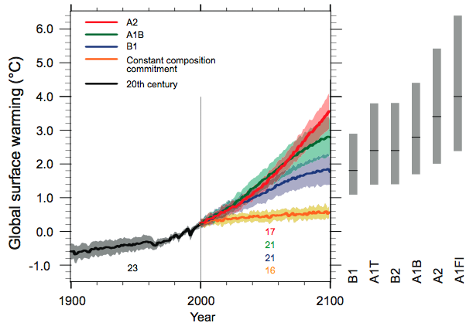
#1. Uncertainty in climate models
Error bar = measure of uncertainty
Further spread for the regional climate changes
Causes of this uncertainty:
  1. Dependence on the initial state (spread in a single model ensemble)
  2. Dependence on parameterization (spread among different models)
In climate change studies, 2 >> 1

Slide 22
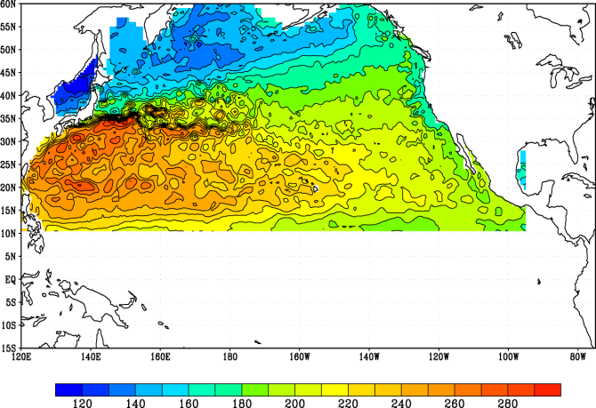
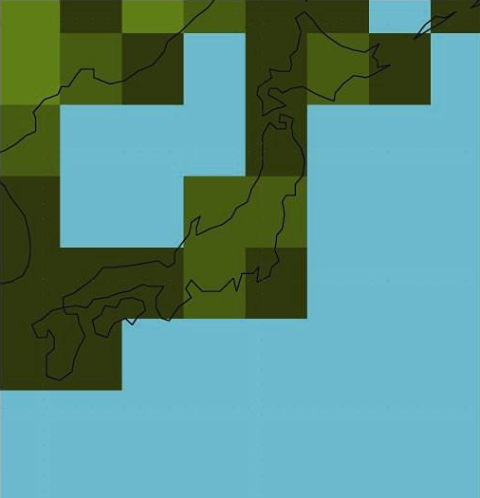
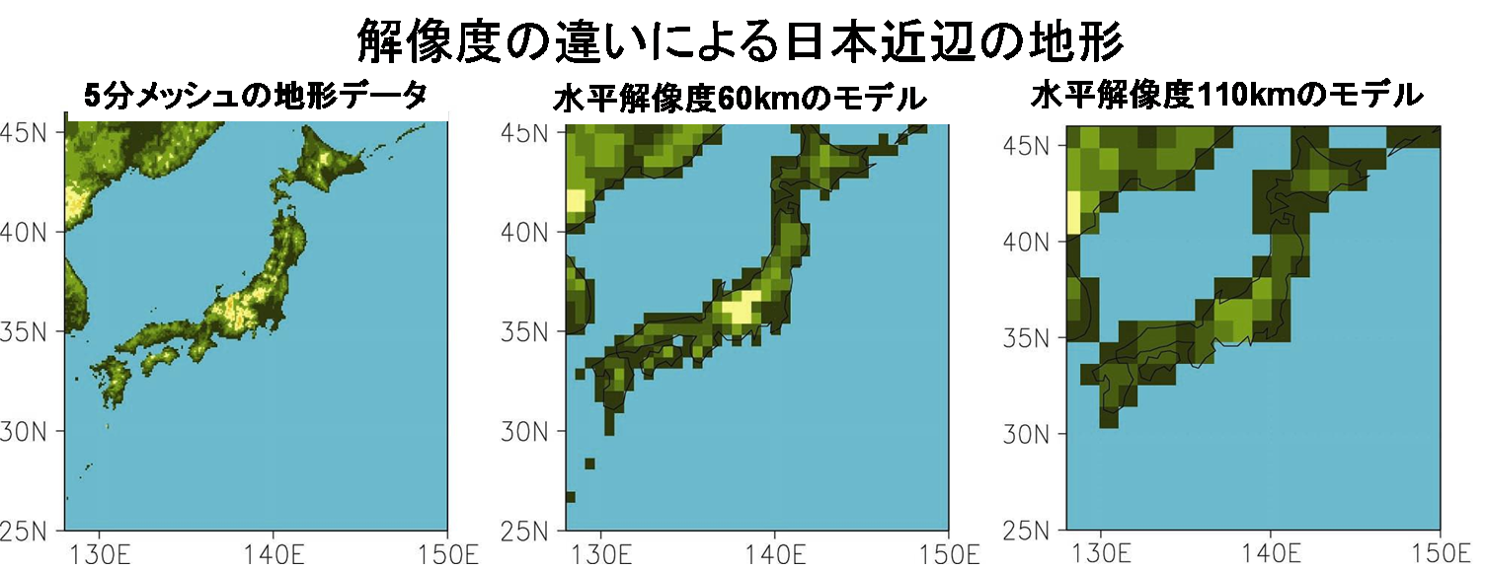
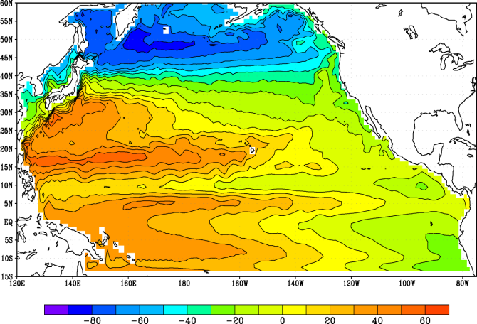
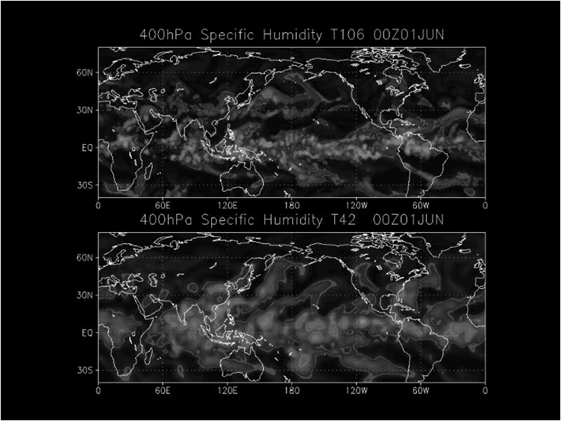
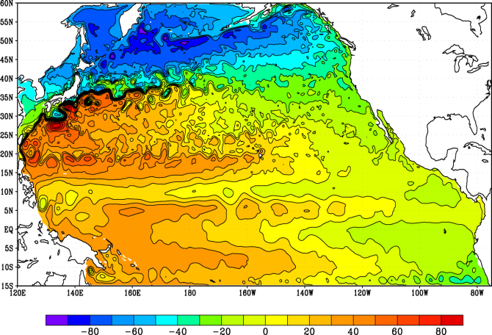
#1 Uncertainty in climate model
High-resolution improves some aspects …
Ocean surface height
Representation of topography
satellite
Δx=280km
Δx=110km
true
1×1°
1/4 × 1/6°
Courtesy of H.Nakano

Slide 23
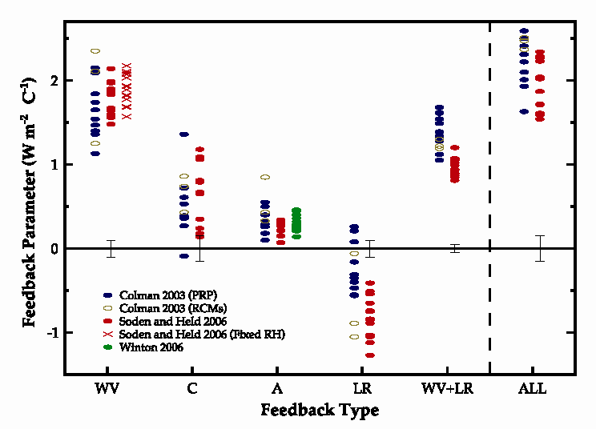
Climate sensitivity and feedbacks
Global mean energy balance
Feedback factor in AR4 models
Equilibrium in perturbed climate
If we assume q, I, C do not change
λ₀ indicates a degree of warming
due to CO₂x2 -> “climate sensitivity”
In reality, q, I, C change when T changes
cloud
total
water vapor
ice-albedo
lapse rate
IPCC (2007)
For β>0, the process amplifies the warming
For β<0, the process suppresses the warming
-> β is called the “feedback factor”

Slide 24
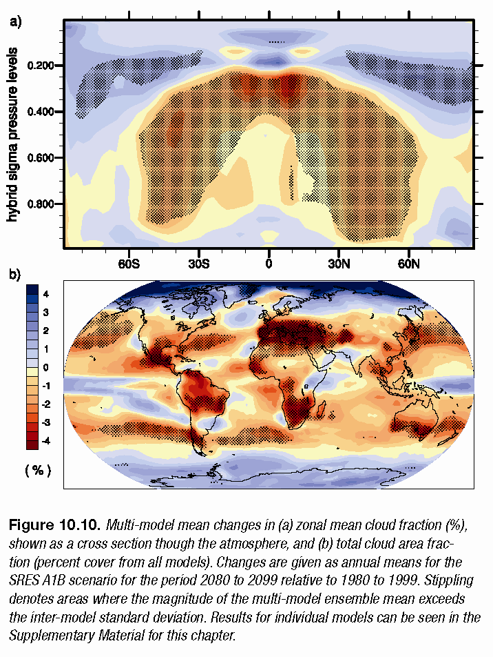
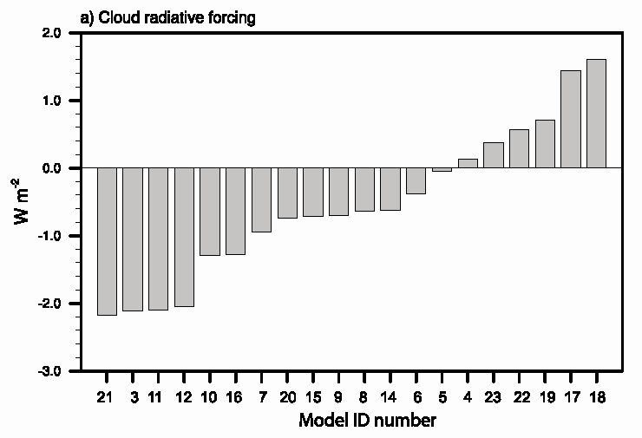
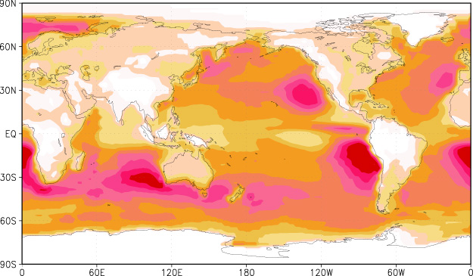
Cloud feedback
Diff. 2080-2099 minus1980-1999 in A1B scenario
Total cloud cover
Change in CRF
Warm the Earth
Cool the Earth
IPCC (2007)
disagree
the change in magnitude and even sign of the cloud-radiative feedback
Models agree to predict decrease
in total cloud, but …..
Low cloud fraction (obs)
Response of low cloud is the key

Slide 25
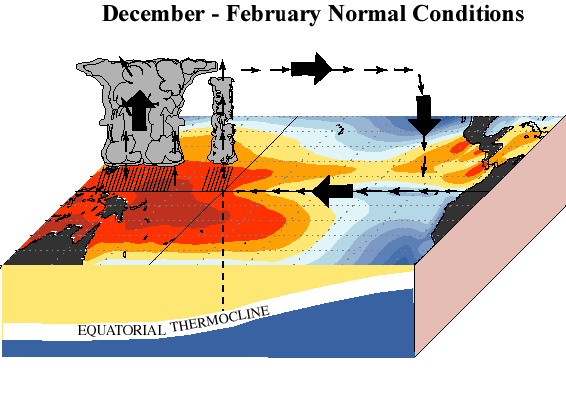
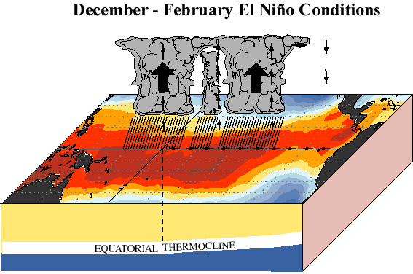
ENSO changes
Normal
El Nino
http://www.cpc.ncep.noaa.gov
El Nino-Southern Oscillation
(ENSO) has a large impact on
worldwide weather, so will be
in future climate
ENSO changes
Ratio of SD of the SLP EOF1 in SRES A2 (2051-2100)
El Nino-like mean state in
warmed climate may be
robust, but …..
large
uncertainty in the change
in ENSO amplitude
Mean state changes
IPCC( 2007)
R( linear trend in 1% CO2 increase run, EOF1 in CTL, 10S-10N, 120E-80W)

Slide 26
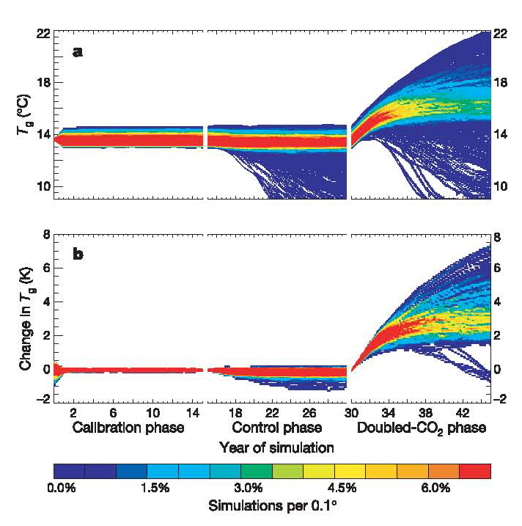
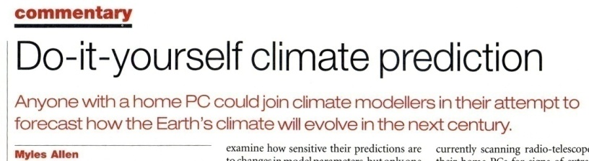
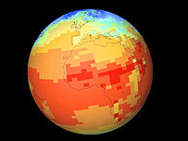
#1 Uncertainty in climate model
Current approaches
Global-mean SAT in 2758 CO2x2 runs
Spread 2K<ΔT<11K !!
Higher resolution
Improvement of the model
parameterization
Estimating uncertainty range
Seamless prediction
IPCC models may underestimate the uncertainty
(small sample size etc.) ⇒ large-sampling using
individual’s PCs worldwide
Alarm at new climate warning
By Richard Black
BBC environment correspondent
Temperatures around the world
could rise by as much as 11C,
according to one
of the largest
climate prediction
projects ever run.
http://www.climateprediction.net
N.Wea. Prediction: hi-res, short run, easy to verify
Clim. prediction: low-res, long run, difficult to verify
Use a unified model for both purposes
Notes:
世界150カ国以上(>9万5千人)のPCを使って行なった2578回の気候シミュレ
ーション結果（地表気温の変化）

Slide 27
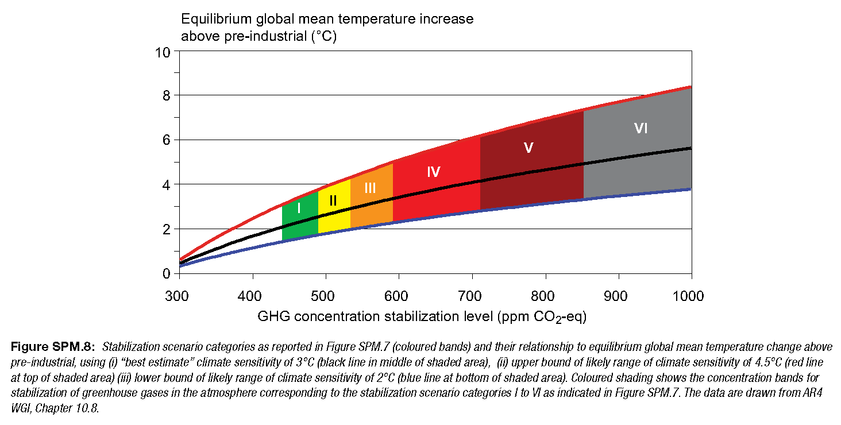
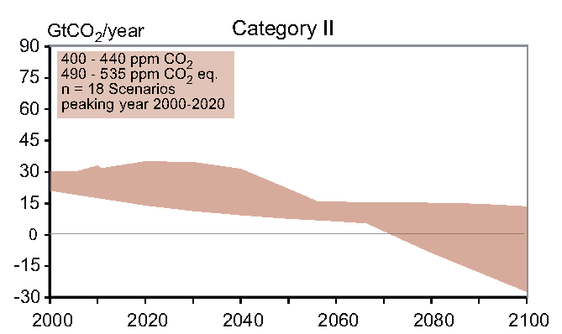
#2. Uncertainty in natural carbon cycle
Climate change scenario (with the Earth System Model, ESM)
Carbon cycle-climate interactions
Climate stabilization scenario wrt future emission
Category II
Global SAT change [K]
Allowable emission
year

Slide 28
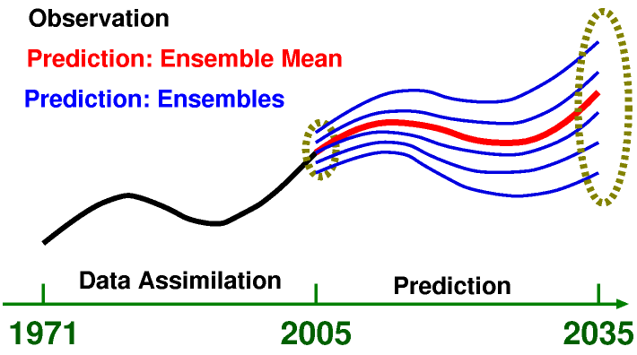
From AR4 to AR5
Lessons from AR4
Near-term climate prediction in AR5
PDF for the SAT change
→ Climate prediction as initial and boundary
value problem
Stott and Kettleborough (2002)
Future projections until 2035 do not
spread out against different socio-
economic scenarios
More accurate near-term predictions
required by policy makers
Coupled data assimilation
Practical initialization for ensemble
Target: both forced response and
internal natural variability

Slide 29
Pilot Decadal Prediction Experiments
1960
70
80
90
2000
10
20
30
7 sets of 10-year Integration
(each 10-mem ensemble)
20C3M
Data Assimilation
Local correlation of SST anomalies (with obs)
5-yr mean
10-yr mean
System for
Prediction and Assimilation by
MIROC

Slide 30
Summary
Climate model is a bunch of programs based on known physical (+semi-empirical) laws for the climate system (atmosphere, ocean, land, sea-ice … )
Current climate models, given external (terrestrial & astronomical) conditions, can reproduce past and present climate and its fluctuation to a certain degree
Future climate projection advanced during the past two decades reveals reliable signal for future warming. But, the range and regionality of the projection still contain large uncertainty
Climate model can never be perfect. How to reduce uncertainty arising from, and how we should think of, the model parameterization is still a challenging issue.

